Slide 1
1 Introduction
Centrally planned economy: A centrally planned economy, also known as a command economy, is an economic system in which a central authority, such as a government, makes economic decisions regarding the manufacturing and the distribution of products.
Socialist transformation: Movements that transformed agriculture, handcraft industry and capitalist industry and commerce into public ownership, collectively or state owned. Most of these finished at the end of 1956.
The "Hu Huanyong-Line", dividing population density of China with the “Heihe-Tengchong” line (or "Aihui-Tengchong" line), was proposed by the Chinese geographer Hu Huanyong to mark the demarcation line. The formation of the Line is closely related to the natural condition such as the topography, geomorphology, climate, and water resources, as well as the social, economic, and human activities.
Total factor productivity (TFP): TFP is a measure of aggregate productivity of all inputs, including labor, capital, land and materials.

Slide 2
Two dual-track systems
The first is between the state and the private sectors (dual-track price reform, Zhang 1984)
Supporting rapid growth of the private sector, while keeping the state sector
Avoiding initial collapse of output, and building coalitions for reform through Pareto improvement policies
Causing efficiency losses and corruption
The second is between product and factor markets (Huang 2010)
Product markets are almost completely liberalized, while factor markets remain heavily distorted
Depressed factor prices are equivalent to taxes on households and subsidies to enterprises, leading to both strong growth and increasing imbalances

Slide 3
2 Reform Strategies
Shock therapy: In economics, shock therapy theorizes that sudden, dramatic changes in national economic policy can turn a state-controlled economy into a free-market economy.
Dual-track price system: The dual-track price system is the intermediate price system from the state control price system to the free market price system.
Asymmetric liberalization of product and factor markets: It is a unique reform approach, which completely liberalizes the product markets while retains extensive interventions in factor markets.
Heavy industry-oriented development strategy vs comparative advantaged-oriented development strategy
Supply-side structural reform: It aims at improving quantity and quality of economic development by adjusting economic structure and optimal use of factors

Slide 4
Political economy explanations
First, an autonomous government enables the central government to adopt highly inclusive economic policies that favor long-term economic growth of the whole society.
Second, economic decentralization gives local governments strong fiscal motivation to develop the local economy.
Third, a meritocratic promotion system gives local officials strong positive incentives and counters the negative consequences of decentralization.

Slide 5
These factors work together?
An autonomous government can adopt long-term pro-growth institutions and policies to benefit the economy
Economic decentralization strongly motivates local officials to take the initiative
A meritocratic promotion system guides these initiatives towards the development of the entire nation

Slide 6
Challenges going forward
What are the new political economy challenges for the Chinese economy reform?
It is increasingly more difficult to continue with Pareto improvement
For instance, settlement of migrant workers in the cities might affect the wellbeing of urban residents in the very short term

Slide 7
The analytical framework
Economic decentralization
Merit-based promotion
Autonomous government
In addition to the virtuous cycle among autonomous government, economic decentralization and merit-based promotion of officials
Development of labor-intensive industries also ensures that a large population benefits from the economic development (which improves income distribution) and therefore supports reform policy
Pareto improvement occurs when a change in allocation harms no one and helps at least one person, given an initial allocation of goods for a set of persons.

Slide 8
3 Political Economy
Political economy: Political economy generally refers to crossover study of economics, law and political science in order to understand the impact of political entities and political environment on market behavior.
Beijing consensus: It consists of three features: a commitment to innovation and experimentation in reforms; a rejection of per capita GDP as the only measure of progress, sustainability and equality also count; and a commitment to self-determination.
Autonomous government: is one that does not form an alliance with, and is not captured by, any interest group in society. It is impartial towards different segments of society, but may have its own interests and agendas.
State capitalism: A form of capitalism in which the state owns or controls most of the means of production and other capital: often very similar to state socialism.
State capacity: The government's ability to accomplish its intended policy goals.
Pareto improvement: When a change in allocation harms no one and helps at least one person, given an initial allocation of goods for a set of persons.

Slide 9
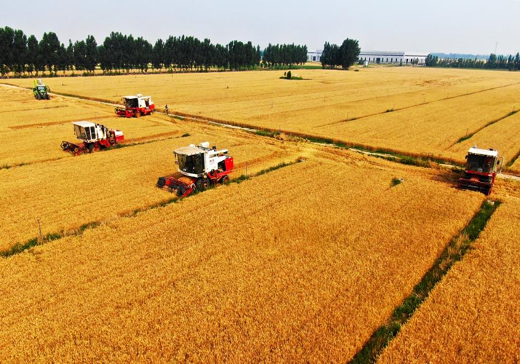
What were the main drivers?
Institutional innovation
Market liberalization

Slide 10
The analytical framework
Chinese agriculture experienced dramatic advancement during the reform period, due to adoption of the household responsibility system and liberalization of agricultural market
But some challenges remain: how to develop agriculture, raise rural income and modernize the rural economy sustainably?
Household responsibility system
Liberalization of agricultural market
Post-reform agriculture:
Rural income
Land ownership
Farm size Labor mobility
Agricultural infrastructure
Pre-reform agriculture: Agricultural collectives Purchase & marketing
Household registration

Slide 11
4 Agricultural Reform
People’s Commune: This was the main form of rural collectives during the central planning period, which owned all agricultural production resources and organized all production and distribution activities. It often contained three levels: Commune, brigade (village) and production team
Household responsibility system (HRS): While the land is still owned by the Communes/collectives, farm households lease pieces of land and manage the entire production process independently.
Food self-sufficiency: A country’s food consumption is supplied entirely by domestic production.
Rural revitalization strategy: The strategy emphasizes the importance of rural development, including the need to develop rural businesses, create a pleasant living environment, promote civility and effective governance, and improve the living standards of rural residents.

Slide 12
The analytical framework
Trade liberalization involves removal of trade restrictions and more broad changes promoting economic openness
Post-reform trade:
How far are we away from free trade?
Reforming trading rights
Reducing trade barriers
Exchange rate policy
WTO
Pre-reform trade: State trading companies
Export/import plans
Official exchange rate

Slide 13
5 Trade Liberalization
Globalization: Globalization is the process of international integration arising from the interchange of world views, products, ideas, and other aspects of culture.
Trade liberalization: Trade liberalization is the removal or reduction of restrictions or barriers on the free exchange of goods between nations. These barriers include tariffs, such as duties and surcharges, and nontariff barriers, such as licensing rules and quotas.
Comparative advantage is an economy's ability to produce a particular good or service at a lower opportunity cost than its trading partners.
Special economic zone (SEZ): SEZ is an area in a country that is subject to different economic regulations than other regions within the same country. The SEZ economic regulations tend to be conducive to—and attract—foreign direct investment (FDI).
Foreign direct investment: A foreign direct investment (FDI) is an investment made by a firm or individual in one country into business interests located in another country.

Slide 14
Pre-reform industry
Urban industrialization in the pre-reform period: central plan + state-owned enterprises
In 1978, SOEs produced 78% of industrial output and employed 76% of industrial workers;
During 1975-1980, SOEs absorbed 84% of increments to industrial fixed assets.
Resource allocation in industry was largely administrative, with prices set to ensure positive cash flows and accounting profits for producers.
Beginning in the 1960s, administrative authority over enterprises, planning and resource allocation increasingly decentralized, which led to the phenomenon of “cellular economy” (Donnithorne 1972).
The basic tenet of the cellular economy perspective is that some combination of official protection and weak physical or institutional infrastructure effectively reserves regional markets for local producers.

Slide 15
From capital- to labor-intensive industries
China produced a lot of heavy industry products, including steel, in which it did not have comparative advantage
Liberalization allowed the enterprises to produce labor-intensive, low value-added manufacturing products, such a footwear, garments, toys
Why was this shift in industrial structure important? Because the new products were actually demanded in local markets and were competitive in international markets
Lin, Cai and Li (1995): comparative advantage oriented development strategy vs. comparative advantage defying development strategy

Slide 16
The impact of liberalization
Three important mechanisms (Sutton 2000)
One, as domestic firms come into closer competition with domestically based rivals, or with imports, prices fall, and the least capable firms may no longer be viable.
Two, an escalation of efforts by surviving firms in respect of capability building leads to higher levels of R&D spending and increased market concentration.
Three, as competition intensifies, the market share gap between more capable firms in each market, and their less capable rivals, widens.

Slide 17
Entry of new firms
Steven Klepper observation
At the start, firms rush to participate in the new market, leading to “excess entry.”
Thereafter, the “escalation” mechanism kicks in: as competition intensifies, successful expansion of capabilities by some firms leads to increased concentration, rising quality thresholds, innovation, and falling prices.
Firms that cannot expand sales sufficiently to support escalating R&D requirements leave the industry, resulting in a “shakeout” that sharply reduces the number of active producers and raises the level of concentration.

Slide 18
Industry policy
Industrial policy refers to policies devised by the government to guide industrial development, promote industrial upgrading, coordinate industrial structure, in order to achieve healthy and sustainable economic development.
Industrial policies a set of polies intervening in industrial formation and development to achieve certain social and economic goals. The key function of the industry policy is to overcome the market failure problem and improve resource efficiency

Slide 19
Controversial issues
Roles of the industrial policy
Importance of the private enterprises, which contributed more than 50% of tax revenues, 60% of GDP growth, 70% of corporate patents, 80% of urban income
Future of the supply chains: Will China lose all the traditional manufacturing industries?

Slide 20
The analytical framework
Industrialization policy during the reform period included entry of new firms, market replacing central plan
Post-reform industry:
Markets
SOEs, foreign and private firms
Evolving industries
Reforming the SOEs
Entry of foreign invested firms and private enterprises
Liberalization of markets
Pre-reform industry: Central plan
State-owned enterprises
Heavy industries

Slide 21
6 Industrialization
Industrialization: Industrialization is the process by which an economy is transformed from primarily agricultural to one based on the manufacturing of goods.
Concentration ratio: The concentration ratio, in economics, is a ratio that indicates the size of firms in relation to their industry as a whole.
Labor- (capital-) intensive products: They refer to products requiring high labor (capital) costs per unit of output.
Township and village enterprises (TVEs): TVEs refer to those enterprises owned by rural (township or village) collectives. They were quite popular between the mid-1980s and the mid-1990s in China.

Slide 22
Four factors facilitated the displacement
First, the government and the Communist Party of China (CPC) very gradually opened the space in which private/foreign firms could operate. (entry)
Second, private/foreign firms on average have been far more productive than SOEs, generating a high level of profits relative to their assets. (competitiveness)
Third, over time, private firms were able to borrow increasing amounts of capital from banks and also were able to raise funds on the Shanghai and Shenzhen stock markets. (expansion)
Fourth, some of the SOEs were later effectively privatized. (exit)

Slide 23
The process of SOE reform: Four stages
1978-1992, Autonomy with the contract responsibility system and competition.
1992-2003, Ownership reform through ‘grasping the large, letting go of the small’.
2003-2013, The State-owned Assets Supervision and Administration (SASAC), large SOEs restructuring, corporatization and going global.
2013- present, Renewed mixed-ownership reform, corporate governance and challenges ahead.
Re-emphasis of importance of SOEs
Relationship between the Party Committee and the Board

Slide 24
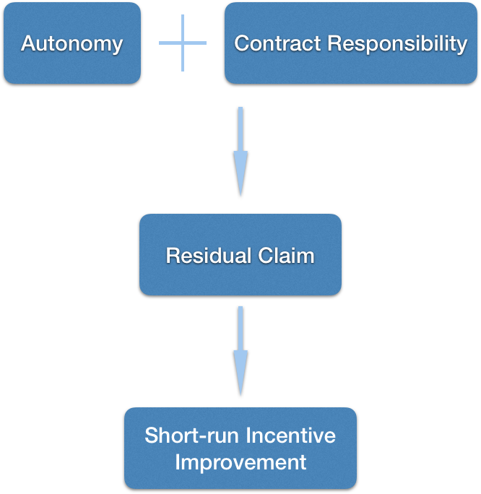
First stage (1978-1992)
Reform measures to improve the performance of SOEs were focused on granting autonomy to SOEs and introducing a market mechanism.
In the early 1980s, an enterprise responsibility system was implemented. profit incentives simply consisted of modest bonus and investment funds, so profit sharing was a small percentage of total enterprise profit.
In 1985, the contract responsibility system was introduced to create a formalized relationship between SOEs and the responsible government agency.
Each firm would contract to remit a fixed amount of profit, and any profit earned above the contracted level—specified in advance between the enterprise and its supervising agency—was kept almost entirely by the enterprise (or at least shared).

Slide 25
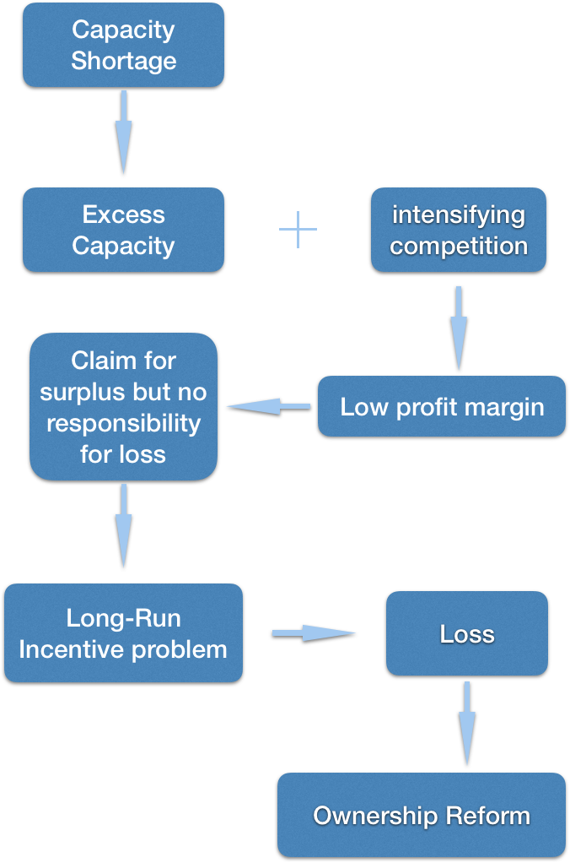
Second stage (1992-2003)
The second stage of reform was characterized by ownership transformation (gaizhi 改制), with a focus on the privatization of SOEs, which began after Deng Xiaoping’s tour of southern China in 1992.
Priority reform steps were taken to develop an institutional framework for the modern enterprise system, based on the western corporate model.
The government issued the Company Law in 1993 and the Competition Law in 1994 ➔ establishing the regulatory framework.
In 1997, the fifteenth National Congress set out the establishment of a social security system and formally approved ‘grasping the large, letting go of the small’.

Slide 26
“Grasping the large, letting go of the small”
In ‘grasping the large, letting go of the small’, policy-makers sought to focus their attention on the largest, typically centrally controlled firms, reorganize them into even larger and hopefully more competitive enterprise groups, and restructure and refinance them, while keeping them under state control.
Tens of thousands of SOEs and urban collective firms were shut down. Laid-off workers totaled 40% of the SOE workforce, and the urban collective workforce shrank by more than two-thirds.

Slide 27
SOE reform: Challenges ahead
At the core of the problem is the ‘impossible trinity’—the attempt to combine improved incentives, enhanced oversight and new missions for the SOEs.
However, these shortcomings should not blind us to the important changes taking place in China’s SOE sector. At a minimum, the system appears to be creating more efficient instruments to carry out China’s industrial policy objectives.
Whether the goal of achieving a more efficient instrument that serves the state’s developmental interests is compatible with a profound restructuring and increased efficiency of the broader state sector depends on the evolution of reform from this point forward. In particular, the scope of the classification of fully competitive commercial enterprises will have particular importance.

Slide 28
Study 1: Competition and policy burdens
The key for a successful SOE reform is to remove the policy burdens and to create a level playing field so that market competition can provide sufficiency information for the managerial performance of the SOEs and make the managers’ incentives compatible with those of the state.
Large corporations in a market economy: owners can design a managerial-compensation scheme that is based on firm’s performance (relative to the industry); a firm’s performance in a competitive market provides a signal to the managerial labor market about the manager’s talent and behavior
The Soviet system was very capable of mobilizing resources but had very low allocative and technical efficiency
SOEs’ policy burdens: (1) too high capital intensity; (2) heavy burdens of retirement pensions, other social welfare costs and redundant workers; (3) some output prices were still distorted.
Failure to harden SOEs’ budget constraint: Privatization would not work as long as the policy burdens remain. It is important to remove policy burdens and to provide a level playing field.
Lin, J. Y., F. Cai and Z. Li, 1998, “Competition, policy burdens and state-owned enterprise reform”, American Economic Review, 88(2): 422-427.

Slide 29
Study 2: Agency problems and political control
Reform policies “expanding enterprise autonomy” and “increasing retained profits”: narrow focus of providing contractual incentives for managers without fundamental transformation of government institutions, ownership structure and corporate governance.
Reality: One, without a change of nominal state ownership, many contractual and residual rights of control were reallocated to managers. Two, the ultimate control rights such as selection and dismissal of managers, approval of large projects, veto powers over the disposal of assets, still remain in the hands of the government and the Party.
Distinguishing agency costs (manager failing) and political costs (government failing)
Economic efficiency and social welfare require both political and agency costs to be reduced: depoliticization, corporate governance and desocialization.
Strategies: formulate a strategy of ownership transformation (letting go of the small); state-owned asset management system to minimize political influence; a diversity of governance structure.
Y. Qian, 1996, “Enterprise reform in China: Agency problems and political control”, Economics of Transition, 4(2): 427-447.

Slide 30
The analytical framework
China’s SOE reform made significant progresses, indicated by its rapidly changing institutional arrangement and its dramatic displacement.
However, many of the policy questions are yet to be answered (competitive neutrality)
Post-reform SOEs:
Greater autonomy/role of market
New challenges: Impossible trinity
Decision autonomy
Dual-price system
Entry of private and foreign firms
Privatization
Pre-reform SOEs: Central plan for production
No incentives for managers and workers

Slide 31
7 SOE Reform
State-owned enterprises: A state-owned enterprise (SOE) is a legal entity that is created by a government in order to partake in commercial activities on the government's behalf. It can be either wholly or partially owned by a government and is typically earmarked to participate in specific commercial activities.
Principal-agent problem: The principal-agent problem is a conflict in priorities between a person or group and the representative authorized to act on their behalf. An agent may act in a way that is contrary to the best interests of the principal.
Soft budget constraint: This refers to the situation where SOEs can always seek subsidies from the government when they make losses (without having to be bankrupted, for instance).
‘Impossible trinity’ of SOE reform: It is impossible to achieve all of the following three objectives: improved incentives, enhanced oversight and new missions for SOEs.
Competitive (or ownership) neutrality: Competitive neutrality means that state-owned and private businesses compete on a level playing field. (OECD)

Slide 32
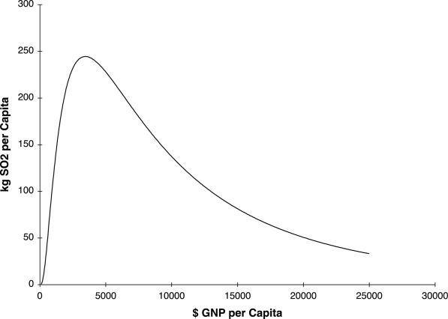
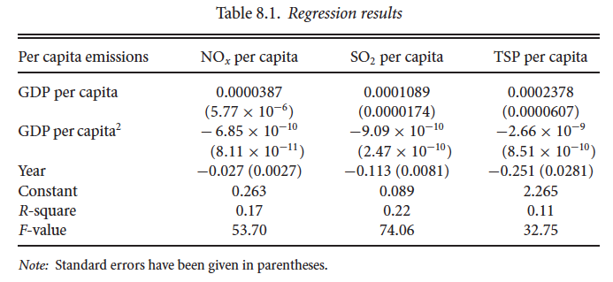
Statistical correlations
Non-linear relationship: Levels of pollution first rise as income becomes higher and then decline after income exceeds certain level

Slide 33
China’s Environmental regulation
Evolution of the policies:
1973, the First National Conference on Environmental Protection
1983, elevated to become the country’s basic national policies
Early 2000s, more rigorous efforts to control air and water pollutions
Institutions
Ministry of Ecology and Environment (which replaced the Ministry of Environmental Protection in 2018)
Ministry of Finance (environmental pollution tax)
National Development and Reform Commission (energy supply and resource recycling and reuse)
Ministry of Industry and Information (energy conservation)
China’s environmental regulation system is composed of three main components: legislation and standards, the planning process, and implementation mechanisms
Valerie J. Karplus, Junjie Zhang, and Jinhua Zhao, 2021, “Navigating and Evaluating the Labyrinth of Environmental Regulation in China”, Review of Environmental Economics and Policy, 15(2).

Slide 34
Pollution vs climate change
Both are results of human economic activities. One important factor behind is energy consumption – composition, efficiency and technology
While pollution is often a local problem, climate change is a global challenge
It is relatively easy to see forces driving the environmental Kuznetz curve. It takes leadership for a country to respond to climate change problems

Slide 35
The analytical framework
Environment and climate change are all new challenges emerged during the past several decades. The biggest challenge for China is that it is still a developing country, but at the same time it is already the largest contributor to pollution and carbon emission
Post-reform:
Balancing between economic activities and environmental protection
Energy sector strategy
Environmental policy
Climate change action
Pre-reform: Environment was not an important factor for economic decision

Slide 36
8 Environmental Protection
Environmental pollution is defined as the contamination of the physical and biological components of the earth/atmosphere system to such an extent that normal environmental processes are adversely affected
Environmental Kuznetz Curve (EKC) is a hypothesized relationship between various indicators of environmental degradation and per capita income. In the early stages of economic growth, pollution emissions increase and environmental quality declines, but beyond some level of per capita income the trend reverses.
Global climate change (GCC) refers to dramatic or sustainable change in the global climate, caused by natural internal process, external force or influences of human activities.
Carbon neutrality means having net-zero carbon dioxide emissions. To achieve this, carbon emissions should be offset by carbon removal. For every amount of carbon a company or a country produces, it should take steps to remove the same amount of carbon from the atmosphere.

Slide 37
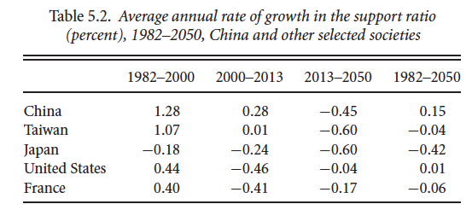
Demographic dividends
The first dividend measures increases in income per capita that occur because the productive population is growing at a faster rate than the total population over part of the demographic transition
The second dividend arises as individual behavior and public policy respond to anticipated changes in population age structure, for example, increases in the importance of retirement (creation of wealth)
Support ratio = Working age people/dependents
(Reversal of the dependency ratio)

Slide 38
Study: End of cheap labor
Potential reasons for rising wages:
Institutional reform: from planned labor allocation system to more market-oriented labor system
Demographic transition and labor shortage: from high to low birthrates since the 1970s
Slowing down of structural changes: the remaining high migration costs (such as Hukou) and those who can have already done so
Li, Hongbin, Lei Li, Binzhen Wu and Yanyan Xiong, 2012, “The end of cheap labor in China”, Journal of Economic Perspectives, 26(4): 57-74.

Slide 39
Some outstanding issues
(1) developing an accurate and timely labor statistical information system to report on key indicators, such as unemployment;
(2) avoiding industrial, financial, and wage policies which push up the wage/rental ratio;
(3) providing an effective safety net for dislocated workers;
(4) developing effective social insurance programs that have broad coverage, avoid work disincentives, and create portable benefits;
(5) integrating migrants into urban areas by equalizing access to education and gradually extending coverage by social assistance and social insurance programs; and
(6) dismantling the household registration system.

Slide 40
The analytical framework
Labor market experienced significant changes, from wage to employment to migration. But in almost all these areas, some policy restrictions remain
Post-reform:
Wage rates are determined by market
labor can move around the country
but social welfare system is not integrated
and income distribution remains a big challenge
Labor mobility
Contract system: hiring and wages
Household registration system
Pre-reform: Urban state sector workers and rural collective farmers

Slide 41
9 Labor Market
The household registration system: It is an administrative system for population, which records information such as birth, death, relatives and legal place of residence.
One child policy: The one-child policy was a policy implemented by the Chinese government as a method of controlling the population, mandating that the vast majority of couples in the country could only have one child. This was intended to alleviate the social, economic and environmental problems associated with the country's rapidly growing population.
Demographic dividend: Demographic dividend refers to the growth in an economy that is the result of a change in the age structure of a country’s population. The change in age structure is typically brought on by a decline in fertility and mortality rates.
Gini coefficient: The Gini coefficient is a measure of the distribution of income across a population. The coefficient ranges from 0 (or 0%) to 1 (or 100%), with 0 representing perfect equality and 1 representing perfect inequality.

Slide 42
The analytical framework
China developed a large platform economy, during the past decade or so, by taking advantages of technological development, large population, low levels of individual rights protection and isolated domestic market.
Challenges today:
How to promote continuous innovation, support fair competition, protect consumer interests and share more widely platform dividends.
2008-2015: Rapid booming
2015-2019: Intensified competition
2020-： Comprehensive governance
The starting point: E-commerce platform Taobao

Slide 43
10 Platform Economy
The platform economy is a new economic model built on internet infrastructure of cloud, network and terminals and takes advantages of digital technology such as artificial intelligence, big data analysis, blockchain technology to match transactions, transmit contents and managing workflows
Long tail refers to the situation that products that are in low demand or have low sales volume can collectively make up a market share that rivals or exceeds the relatively few current bestsellers and blockbusters, but only if the store or distribution channel is large enough.
Network externalities: The effects a product or service has on a user while others are using the same or compatible products or services (positive or negative network externalities).
Big data refers to the large, diverse sets of information. It encompasses the volume of information, the velocity at which it is created and collected, and the variety of the data points being covered (known as the "three v's" of big data).
“Contestability” is a theory of how to realize perfect competition under the condition of economies of scale. The key is about sunk cost or entry barrier.

Slide 44
Tax modernization
The major fiscal reform of 1994 aimed to “recentralize” the fiscal system.
Three key components:
Tax sharing, tax modernization, and tax administration
Tax modernization: simplifying the tax structure, eliminating distortionary elements, and increasing transparency
The complex system of turnover taxes borrowed from the Soviet Union was replaced with a value-added tax (VAT) (primarily 17% then and 13% right now)
On eleven products an excise tax (the consumption tax, CT), in addition to VAT: tobacco, alcohol, cosmetics, jewelry, gas and kerosene, and motor vehicles
A business tax is applied to services including banking and insurance, wholesale and retail trade, transfer of real estate and invisible assets, and entertainment, generally at a rate of 5 percent of turnover

Slide 45
Assessment of the 1994 reform
Fundamentally changed the incentives for local governments
While reducing fiscal incentives for promoting local industry, the TSS also shifted incentives more toward commerce and trade by expanding the business tax on services and assigning it to local governments where it has become an important revenue source that rivals the VAT
By sharing VAT revenues with local governments at a flat rate by origin, the TSS introduced a highly dis-equalizing feature to revenue sharing, ensuring that revenue-rich regions keep more
Because the TSS recentralized revenues but left expenditure assignments unchanged, it created a huge fiscal gap for local governments

Slide 46
Study: Growth effects of TSS
Question: whether implementation of the TSS in 1994 meant a re-centralization to the extent of a reversal to the old system or rather a move to further the process of rationalization of market institutions.
While traditional approaches focused on endogenous proxies of ﬁscal centralization ﬁnd conﬂicting and fragile results, our quasi-experimental approach utilizing a large-scale policy experiment in China with staggered timing to implementation provides consistent and robust estimates.
The increase in revenues for the central government brought about by TSS reform allows the central government to internalize externalities associated with public goods provision, coordinate economic activity across disparate regions, provide ﬁscal support for macroeconomic stability, and provide insurance in response to asymmetric shocks. Future work will explore these mechanisms in greater depth to better understand the optimal level of ﬁscal federalism in China.
Ding, Yi, Alexander McQuoid and Cem Karayalcin, 2019, “Fiscal decentralization, fiscal reform and economic growth in China”, China Economic Review, 53: 152-167.

Slide 47
An assessment of the latest reform
This new fiscal reform was comprehensive in scope and extremely far reaching. When completed, the new government financial reporting system will provide detailed information on the true size and operations of the public sector that will support more sophisticated whole-of-government analyses
Significant progresses have been made in improving reporting system, especially increases in transparency of local government financial reporting
But these reforms are just starting and it is too early to draw a definitive conclusion

Slide 48
The analytical framework
The fiscal policy is transformed from a means of central planned policy tool to a policy instrument aiming at achieving goals such as stable prices, balanced sustainable economic growth, reasonable income distribution, appropriate resource allocation and good quality of social life
A modern fiscal system:
Central-local governments relations
Tax revenues and public services
Quality of public finance
Balancing the budget and increasing local incentive
The 1994 fiscal policy reform/The budget law
The 3rd plenum blueprint/2014 budget law revision
Pre-reform fiscal system:
Unified revenue collection and budgetary spending

Slide 49
11 Fiscal System
Public finance: Public finance refers to the state/government’s distributional and economic activities in order to satisfy public needs, including collection of social resources and provision of public goods and services. (Public Economics concerns with both positive and negative externalities and deals with issues of social optimality.)
Fiscal policy: Fiscal policy refers to the use of government spending and tax policies to influence economic conditions, especially macroeconomic conditions, including aggregate demand for goods and services, employment, inflation, and economic growth.
Tax sharing system (TSS) was introduced after the 1994 reform, under which tax revenues are assigned to central government, local government, or shared
Transfer payment: Here transfer payment refers to the amount of fiscal revenues that the central government transfers to local governments.
Extra budget fund (EBF) refers to special account segregated from the budget and revenues raised outside the budgetary framework

Slide 50
Policy logic, again
The dual-track reform approach (crossing the river by touching the stones)
The asymmetric liberalization of markets
Financial repression is an important way of factor market distortion

Slide 51
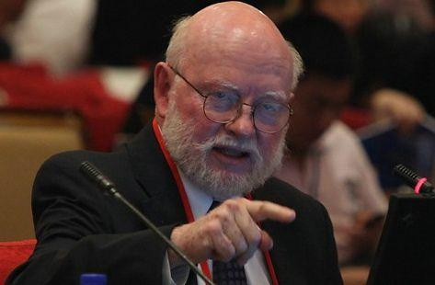

The McKinnon/Stiglitz effects
Positive effects of financial repression on growth and stability during the early stage of reform, turning to negative during the later stage
McKinnon effect
Stiglitz effect

Slide 52
The analytical framework
Starting with a single-institution financial system, China’s financial reform process was about creation of a market-oriented financial system
Building a new system: Creating financial institutions and capital markets
Liberalization of market mechanism: Risk pricing and fund allocation
Financial opening: The financial service sector, capital account liberalization and RMB internationalization
Modern Financial system:
Large in size
weak in regulation
heavy in government intervention
Pre-reform financial system: Peoples’ Bank of China

Slide 53
12 Financial Reform
Financial repression: Financial repression is a term that describes measures by which governments channel funds from the private sector to themselves as a form of debt reduction. In academic analysis, it refers to various ways that the state intervenes in operation of financial system.
Loan prime rate: LPR is the weighted average of representative banks’ lending rates for their prime customers, relative to the open market rate. LPR was introduced as a way of lending rate liberalization for commercial banks.
Direct finance/indirect finance: Direct finance is a method of financing where borrowers borrow funds directly from the financial market without using a third party service, such as a financial intermediary. Indirect Finance is a method of financing where borrowers borrow funds indirectly from the financial market through a third party service, such as a financial intermediary.

Slide 54
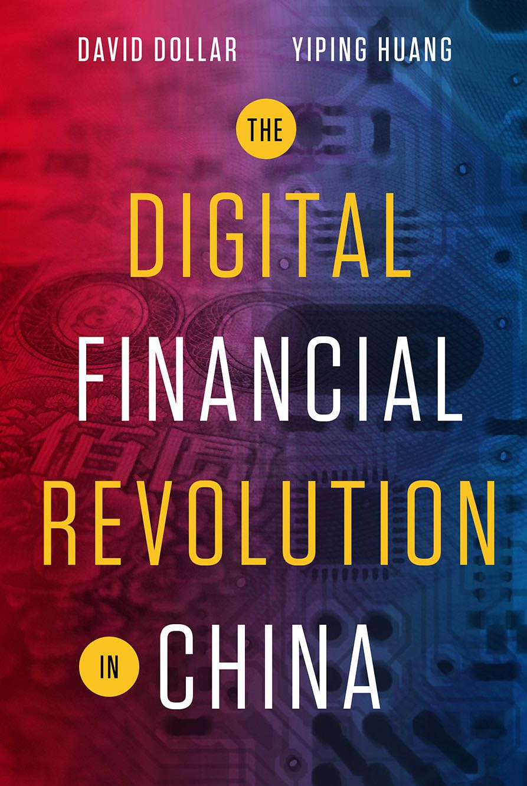
Some preliminary takeaways
Digital finance in China has strong quality of financial inclusion. And China already is on the frontier of some digital financial businesses
Some businesses are more successful (mobile payment and bigtech credit), others are unsuccessful (P2P and robo advice). Key determinants: market demand, financial logic and effective regulation
All financial transactions need to be covered by financial regulation, which should set entry barriers and operating rules. Regulation should also innovate, including adopting sandbox
New policy frameworks are required for defining ownership and rights of data, data sharing and pricing of data to ensure fair competition and privacy protection

Slide 55
13 Fintech Revolution
Financial inclusion: Financial inclusion refers to efforts to make financial products and services accessible and affordable to all individuals and businesses, regardless of their personal net worth or company size.
Digital finance (Fintech): Digital finance refers to business activities utilize digital technologies, such as digital platform, big data, artificial intelligence and cloud computing, to problems solutions to financial problems. It includes mobile payment, digital lending, online investment, digital insurance and central bank digital currency.
Mobile payment service: A mobile payment is a money payment made for a product or service through a portable electronic device such as a tablet or cell phone. .
Bigtech credit: Large technology companies (Bigtech) make loans by relying on Bigtech platforms and big data analyses.
Central bank digital currency (CBDC): CBDC refers to the digital form of sovereign currencies issued by central banks. CBDC can be divided into retail or wholesale ones.

Slide 56
New challenges
loss of low cost advantage
population ageing
protectionism
carbon emission

Slide 57
New economic policy strategy
New economic development pattern: relying mainly on domestic economic circulation, with close collaboration between domestic and external circulations
The economy will probably become more domestic oriented. But that does not mean the policies will become inward-looking
The key pillars supporting this new strategy include: strengthening of domestic demand (consumption) and acceleration of industrial upgrading through innovation

